Slide 1
Step 1: Using the Gibbs Free Energy Equation The spontaneity of a reaction is determined by Gibbs free energy:
ΔG=ΔH−TΔS
For the reaction to be non-spontaneous, ΔG must be greater than zero (ΔG > 0).
The transition point between spontaneity and non-spontaneity occurs when ΔG = 0:
0=Δ𝐻−𝑇Δ𝑆
Solving for T:
T= ΔH​ /ΔS

Slide 2
Step 2: Plugging in the Given Values
ΔH = -120 kJ
ΔS = -0.4 kJ/K
T= −120​/−0.4
T=300K
At T = 300 K,
The reaction is at equilibrium (ΔG = 0), meaning it is neither spontaneous nor non-spontaneous.
Step 3: Understanding the Non-Spontaneity Condition
The reaction is spontaneous when ΔG < 0.
The reaction is non-spontaneous when ΔG > 0.
Since this is an exothermic reaction (ΔH < 0) and ΔS < 0, the term (-TΔS) becomes positive as temperature increases.
If T < 300 K, ΔG is negative, meaning the reaction is spontaneous.
If T > 300 K, ΔG is positive, meaning the reaction is non-spontaneous.
Thus, above 300 K, the reaction becomes non-spontaneous.

Slide 3
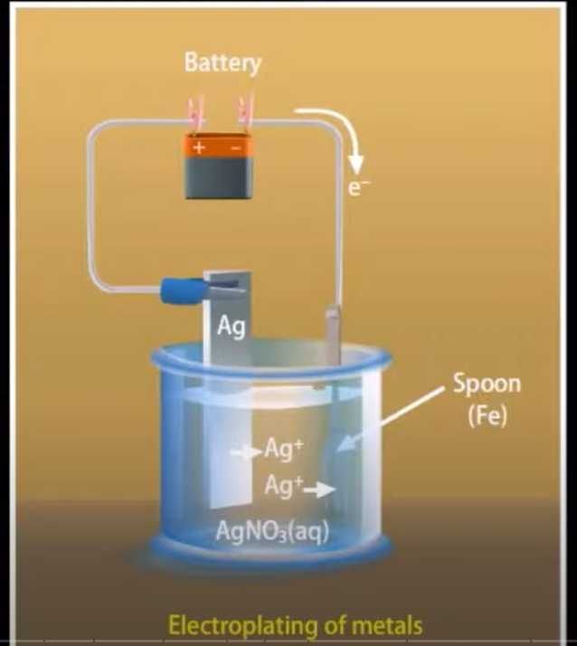
Electrochemistry
It’s a branch of chemistry that deals with the study of the relationship between electric energy and chemical energy and the conversion of one form to another.
Electroplating
Metal purification
Batteries,
corrosion,
electrolysis, fuel cells.
https://ptable.com/?lang=en#Electrons/OxidationStates

Slide 4
Electrochemical cell
A device in which chemical energy is converted into electrical energy.
also called as Galvanic cell or voltaic cell

Slide 5
The anode and Cathode are the two electrodes in an electrochemical cell where oxidation and reduction occur, respectively.
Their behavior differs in Galvanic (Voltaic) Cells and Electrolytic Cells.
"An Ox, Red Cat" → Anode = Oxidation, Cathode = Reduction
Electrode | Galvanic (Voltaic) Cell | Electrolytic Cell
Anode | Site of oxidation (loses electrons), negative electrode | Site of oxidation (loses electrons), positive electrode (connected to power source)
Cathode | Site of reduction (gains electrons), positive electrode | Site of reduction (gains electrons), negative electrode

Slide 6
Electrolytic Vs Galvanic (Voltaic cell)

Slide 7
Anions vs. Cations
These are types of ions (charged particles) in an electrochemical cell.
Anion (A Negative ION) → Moves to the Anode
Cation (T looks like a +, meaning positive) → Moves to the Cathode
Example: NaCl in water → Na⁺ (cation) moves to the cathode,
Cl⁻ (anion) moves to the anode.
Ion Type | Charge | Movement
Anion | Negative (-) | Moves toward the anode
Cation | Positive (+) | Moves toward the cathode

Slide 8
Oxidation vs. Reduction
These are the two parts of a Redox (Reduction-Oxidation) reaction:
OIL RIG → "Oxidation Is Loss, Reduction Is Gain" (of electrons)
LEO GER → "Lose Electrons = Oxidation, Gain Electrons = Reduction"
Zn(s) → Zn²⁺ (aq) + 2e⁻ (∗∗Oxidation at Anode∗∗)
Cu²⁺(aq) + 2e⁻ → Cu(s) (∗∗Reduction at Cathode∗∗)
Process | Definition | Electron Movement
Oxidation | Loss of electrons | Electrons are released
Reduction | Gain of electrons | Electrons are accepted

Slide 9
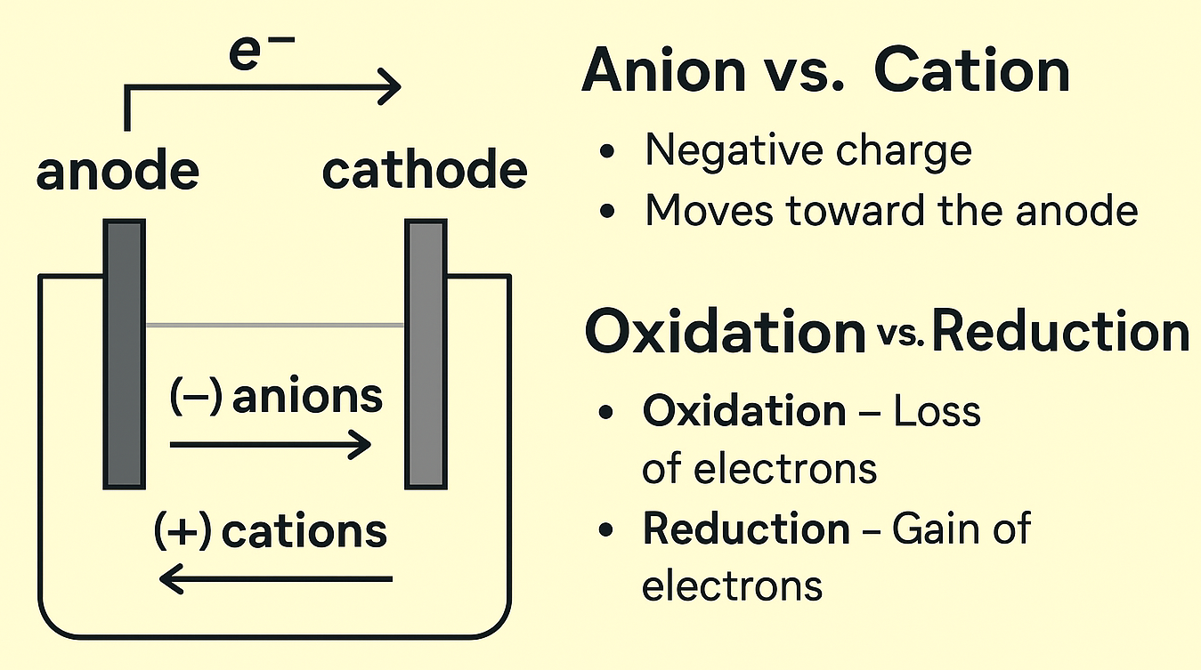
In a Zn-Cu Galvanic Cell:

Slide 10
Galvanic (Voltaic) Cells
Definition: A device that converts chemical energy into electrical energy through spontaneous redox reactions.
Components: Anode (oxidation site, negative electrode).
Cathode (reduction site, positive electrode).
Salt bridge (maintains charge balance).
Example: Zn-Cu Cell
Zn(s) | Zn²⁺(aq) || Cu²⁺(aq) | Cu(s)
Electron Flow: From anode to cathode.

Slide 11
Electrolytic Cells
Definition: Uses electrical energy to drive a non-spontaneous reaction.
Key Differences from Galvanic Cells:
Requires an external power source.
The anode is positive, and the Cathode is negative.
Electrons still flow from anode to cathode.
Example: Electrolysis of water
Splitting H₂O into H₂ and O₂ using an external voltage.

Slide 12
Standard Electrode Potentials (E°)
Definition: The tendency of a substance to be reduced, measured in volts (V).
Reference Electrode: Standard Hydrogen Electrode (SHE), E° = 0V.
Key Formula:
E_{cell}º = E_{cathode}º - E_{anode}º
Example Calculation:
Zn²⁺/Zn (E° = -0.76V) and Cu²⁺/Cu (E° = +0.34V)
E°cell = (+0.34V) - (-0.76V) = +1.10V → Spontaneous reaction.

Slide 13
Applications of Electrochemistry
Batteries: Lead-acid, lithium-ion, fuel cells.
Corrosion & Prevention:
Rusting of iron (Fe → Fe²⁺ + 2e⁻).
Prevention: Galvanization, sacrificial anodes.
Industrial Electrolysis:
Extraction of metals (Aluminum from bauxite).
The production of chlorine gas from NaCl electrolysis.

Slide 14
Summary & Assignment
Key Takeaways:
Electrochemistry is based on redox reactions.
Galvanic cells generate electricity; electrolytic cells consume it.
Cell potential determines spontaneity.

Slide 15
